Slide 1
Yahoo’s PureCSS & jQuery plugins 11 November 2013
Simon Stewart
@SimonStewart
nVisionIT

Slide 2
My life
Chief architect at nVisionIT
Founder of JSinSA ← awesome javascript conference
Founder of @FindFreeWiFi and others
Big javascript fan …

Slide 3
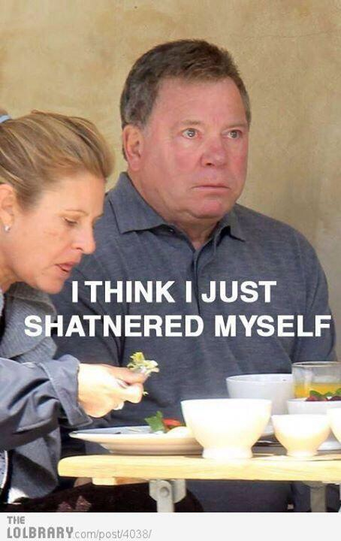

Slide 4
Agenda
Pure CSS
jQuery plug-ins
Developer quiz with prizes

Slide 5
Why do we need HTML frameworks?
<html></html>
Hand-crafted
Time to market
POC
Common framework for the team
Outsourced effort
Responsive
Prettiness
HTML5

Slide 6
The argument against HTML frameworks
My clients want a unique look/feel
I want to write the HTML myself
It’ll take too long to learn another framework
Does this mean I don’t have to know CSS/HTML and can just use the Clipboard Pattern?
But, what about the [insert project from 5 years ago] framework

Slide 7
The argument against HTML frameworks
My clients want a unique look/feel
No they don’t (hint: your client’s don’t read Hacker News)
The frameworks are extensible / themeable
I want to write the HTML myself
You can, just not from scratch <html></html>
It’ll take too long to learn another framework
Don’t be lazy
Does this mean I don’t have to know CSS/HTML and can just use the Clipboard Pattern?
No
But, what about the [insert project from 5 years ago] framework
Things change. Re-evaluate

Slide 8
PureCSS
From Yahoo!
“A set of small, responsive CSS modules that you can use in every web project”
Elegant, simple, lightweight, extensible
Built on normalize.css
Responsive

Slide 9
PureCSS components
Base
Grids
Forms
Buttons
Tables
Menus

Slide 10
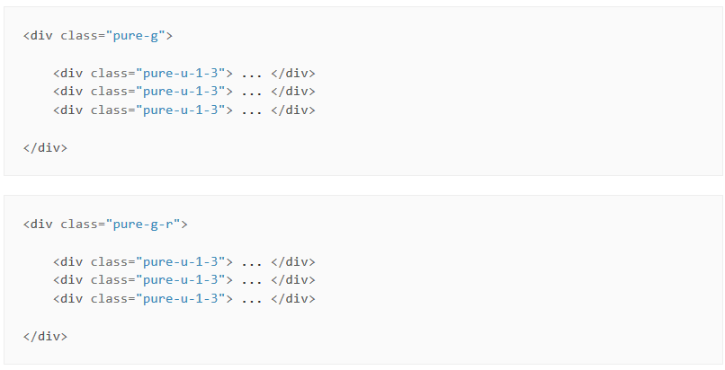
Pure grids

Slide 11
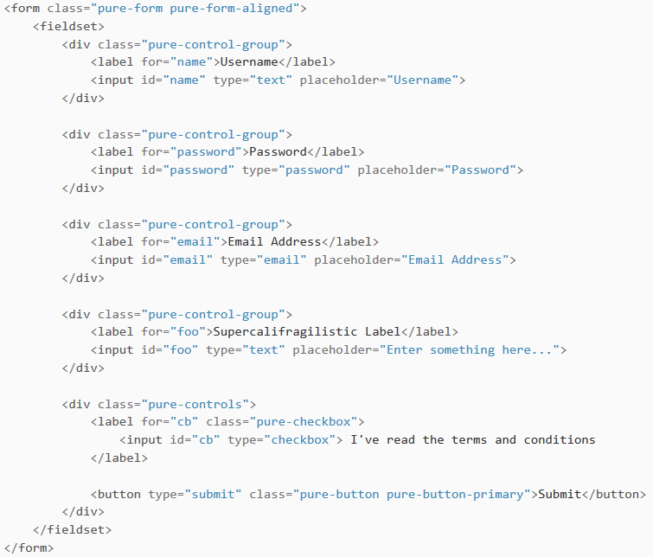
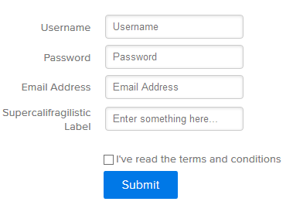
Pure forms

Slide 12
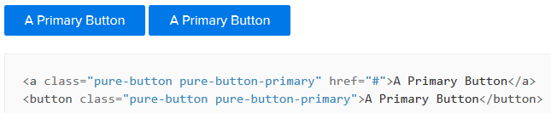
Pure buttons

Slide 13
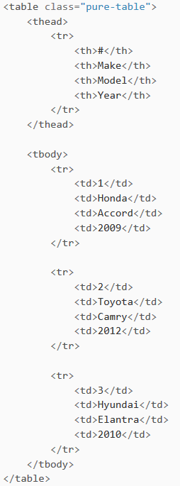
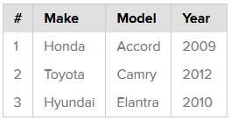
Pure tables

Slide 14
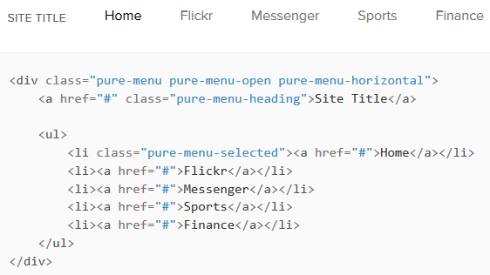
Pure menus
Optional YUI lib

Slide 15
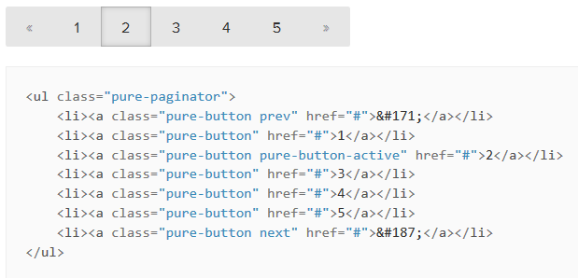
Pure menus

Slide 16
Pure vs Bootstrap
Different use case
Bootstrap = complete UX package + js
PureCSS = minimalist building blocks + BYOJS
Bootstrap:
Pure:
Pros | Cons
Complete solution | Difficult to override
Available themes | Big – and you may not need it all
Super easy & complete | IE 7 not officially supported
Pros | Cons
Easy to override / extend | Version 0.3
Lightweight | Big – and you may not need it all
IE 7+ | Not a complete web site template

Slide 17
Pure vs Bootstrap sizes
Pure | Bootstrap V3
19 KB | 101 KB
1662 lines | 7098 lines

Slide 18
Pure
Demos

Slide 19




How do you choose?
Good web knowledge
No
Yes
Extent of customisation
W3Schools
Min
Max

Slide 20
Regardless of what you choose
Know the fundamentals
Know the framework
Don’t include bits you don’t need know
Don’t use it just because it’s there

Slide 21
Links of interest
Pure
http://purecss.io
http://yui.github.io/skinbuilder/?mode=pure
Yahoo YUI
http://yuilibrary.com
Bootstrap themes
https://wrapbootstrap.com
Other options:
http://topcoat.io
http://semantic-ui.com
http://foundation.zurb.com/

Slide 22

Part 2 : jQuery plugins

Slide 23
Plug-in best practices
Don’t pollute the fn namespace
1 plug-in : 1 function
Provide options
Exposing bits
Keeping bits private

Slide 24
Demos
Simple walkthroughs
Production (i.e. complex plug in) walkthrough

